Slide 1
ARDUINO
PRACTICA 3
LCD TECLADO 4X4

Slide 2
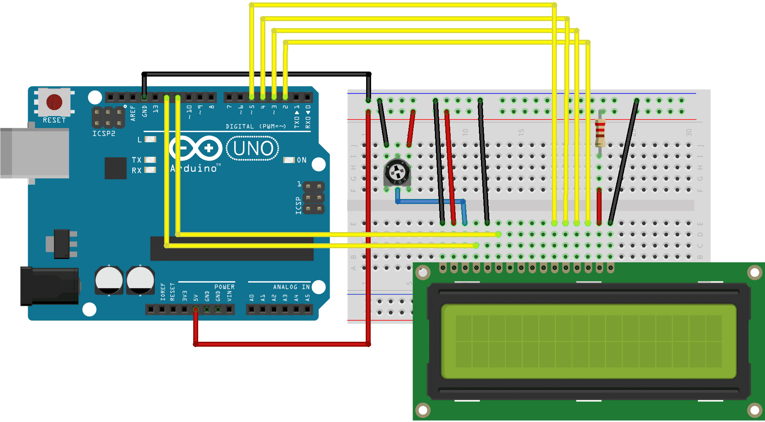
CIRCUITO
PROGRAMA LCD

Slide 3
PROGRAMA USO LCD
// include the library code:
#include <LiquidCrystal.h>
const int rs = 12;
const int en = 11;
Const int d4=5, d5=4, d6=3, d7 = 2;
LiquidCrystal lcd(rs, en, d4, d5, d6, d7);
void setup()
{
lcd.begin(16, 2);
lcd.print("hello, world!");
delay(1000);
}
void loop()
{
for (int pCont = 0; pCont < 13; pCont++)
{
lcd.scrollDisplayLeft();
delay(150);
}
for (int pCont = 0; pCont < 29; pCont++)
{ lcd.scrollDisplayRight();
delay(150);
}
for (int pCont = 0; poCont < 16; pCont++)
{
lcd.scrollDisplayLeft();
delay(150);
}
delay(1000);
}

Slide 4
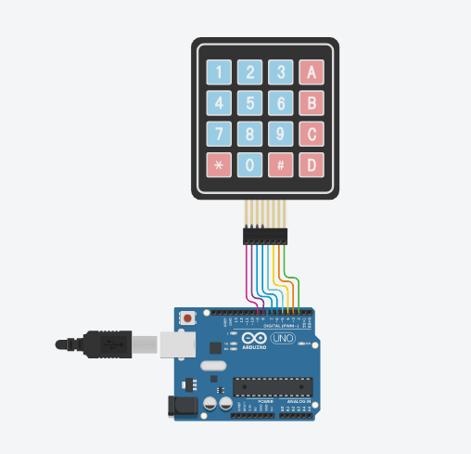
PROGRAMA TECLADO 4X4
#include <Keypad.h>
const byte ROWS = 4;
const byte COLS = 4;
char hexaKeys[ROWS][COLS] = { {'1', '2', '3', 'A'},
{'4', '5', '6', 'B'},
{'7', '8', '9', 'C'},
{'*', '0', '#', 'D'} };
byte rowPins[ROWS] = {9, 8, 7, 6};
byte colPins[COLS] = {5, 4, 3, 2};
Keypad customKeypad = Keypad(makeKeymap(hexaKeys), rowPins, colPins, ROWS, COLS);
void setup()
{ Serial.begin(9600);
}
void loop()
{
char customKey = customKeypad.getKey();
if (customKey)
{ Serial.println(customKey);
}
}

Slide 5
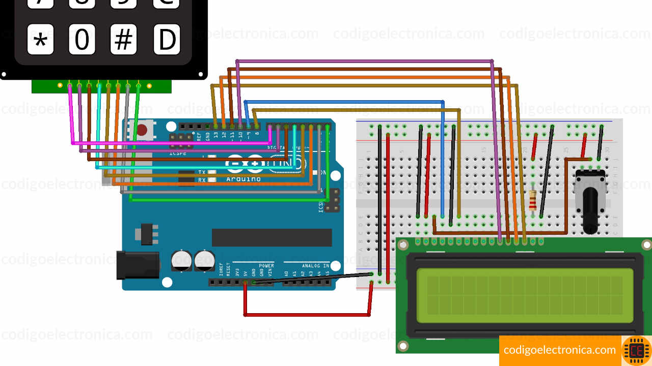
CIRCUITO
TECLADO 4x4 LCD

Slide 6
CIRCUITO
TECLADO 4x4 LCD
//Paso 1
#include <Keypad.h>
#include <LiquidCrystal.h>
//Paso 2
const byte ROWS = 4;
const byte COLS = 4;
//Paso 3
char hexaKeys[ROWS][COLS] = { {'1', '2', '3', 'A'},
{'4', '5', '6', 'B'},
{'7', '8', '9', 'C'},
{'*', '0', '#', 'D'} };
//Paso 4
byte rowPins[ROWS] = {3, 2, 1, 0};
byte colPins[COLS] = {7, 6, 5, 4};
//Paso 5
LiquidCrystal lcd(9, 8, 10, 11, 12, 13);
Keypad myKeypad = Keypad( makeKeymap(hexaKeys), rowPins, colPins, ROWS, COLS);
//Paso 6
void setup()
{ lcd.begin(16,2);
lcd.setCursor(0,0);
lcd.print(“ CURSO uPROCESADORES");
lcd.setCursor(0,1);
lcd.print(“PROGRAMACION");
delay(2500);
lcd.clear();
}
void loop()
{
//Paso 7
char key = myKeypad.getKey();
if (key != NO_KEY)
{ lcd.setCursor(0, 0);
lcd.print(key);
}
}

Slide 7
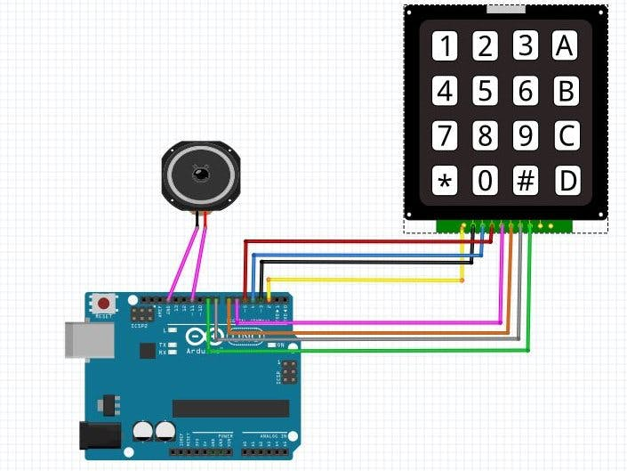
APLICACIÓN TECLADO 4x4 Y LCD
Órgano Electrónico

Slide 8
ORGANO SIMPLE TECLADO 4X4
if(digitalRead(c0)==LOW)
{ TCCR2A = B01000011;
TCCR2B = B00001110;
OCR2A=119;
delay(100);
TCCR2B=B00001000;
TCCR2A = B00000000;
digitalWrite(11,LOW);}
else if(digitalRead(c1)==LOW)
{ TCCR2A = B01000011;
TCCR2B = B00001110;
OCR2A=106;
delay(100);
TCCR2B=B00001000;
TCCR2A = B00000000;
digitalWrite(11,LOW);}
else if(digitalRead(c2)==LOW)
{ TCCR2A = B01000011;
TCCR2B = B00001110;
OCR2A=94; delay(100);
TCCR2B=B00001000;
TCCR2A = B00000000;
digitalWrite(11,LOW);}
else if(digitalRead(c3)==LOW)
{ TCCR2A = B01000011;
TCCR2B = B00001110;
OCR2A=89;
delay(100);
TCCR2B=B00001000;
TCCR2A = B00000000;
digitalWrite(11,LOW);}
digitalWrite(r0,HIGH);
digitalWrite(r1,LOW);
digitalWrite(r2,HIGH);
digitalWrite(r3,HIGH);
if(digitalRead(c0)==LOW)
{ TCCR2A = B01000011;
TCCR2B = B00001110;
OCR2A=79;
delay(100);
TCCR2B=B00001000;
TCCR2A = B00000000;
digitalWrite(11,LOW);}
else if(digitalRead(c1)==LOW)
{ TCCR2A = B01000011;
TCCR2B = B00001110;
OCR2A=71;
delay(100);
TCCR2B=B00001000;
TCCR2A = B00000000;
digitalWrite(11,LOW);}
else if(digitalRead(c2)==LOW)
{ TCCR2A = B01000011;
TCCR2B = B00001110;
OCR2A=63;
delay(100);
TCCR2B=B00001000;
TCCR2A = B00000000;
digitalWrite(11,LOW);}
//Arduino Keypad 4x4 Piano
//This is a remix of viral science project
#define c3 9
#define c2 8
#define c1 7
#define c0 6
#define r3 5
#define r2 4
#define r1 3
#define r0 2
void setup()
{ Serial.begin(9600);
pinMode(c0,INPUT_PULLUP);
pinMode(c1,INPUT_PULLUP);
pinMode(c2,INPUT_PULLUP);
pinMode(c3,INPUT_PULLUP);
pinMode(r0,OUTPUT);
pinMode(r1,OUTPUT);
pinMode(r2,OUTPUT);
pinMode(r3,OUTPUT);
pinMode(11,OUTPUT);
}
void loop()
{ digitalWrite(r0,LOW);
digitalWrite(r1,HIGH);
digitalWrite(r2,HIGH);
digitalWrite(r3,HIGH);

Slide 9
else if(digitalRead(c3)==LOW)
{ TCCR2A = B01000011;
TCCR2B = B00001110;
OCR2A=59;
delay(100);
TCCR2B=B00001000;
TCCR2A = B00000000;
digitalWrite(11,LOW);}
digitalWrite(r0,HIGH);
digitalWrite(r1,HIGH);
digitalWrite(r2,LOW);
digitalWrite(r3,HIGH);
if(digitalRead(c0)==LOW)
{ TCCR2A = B01000011;
TCCR2B = B00001110;
OCR2A=25;
delay(100);
TCCR2B=B00001000;
TCCR2A = B00000000;
digitalWrite(11,LOW);}
else if(digitalRead(c1)==LOW)
{ TCCR2A = B01000011;
TCCR2B = B00001110;
OCR2A=20;
delay(100);
TCCR2B=B00001000;
TCCR2A = B00000000;
digitalWrite(11,LOW);}
else if (digitalRead(c2)==LOW){
TCCR2A = B01000011;
TCCR2B = B00001110;
OCR2A=10;
delay(100);
TCCR2B=B00001000;
TCCR2A = B00000000;
digitalWrite(11,LOW);}
else if(digitalRead(c3)==LOW)
{ TCCR2A = B01000011;
TCCR2B = B00001110;
OCR2A=50; delay(100);
TCCR2B=B00001000;
TCCR2A = B00000000;
digitalWrite(11,LOW);}
digitalWrite(r0,HIGH);
digitalWrite(r1,HIGH);
digitalWrite(r2,HIGH);
digitalWrite(r3,LOW);
if(digitalRead(c0)==LOW)
{ TCCR2A = B01000011;
TCCR2B = B00001110;
OCR2A=50;
delay(100);
TCCR2B=B00001000;
TCCR2A = B00000000;
digitalWrite(11,LOW);}
else if(digitalRead(c1)==LOW)
{ TCCR2A = B01000011;
TCCR2B = B00001110;
OCR2A=50;
delay(100);
TCCR2B=B00001000;
TCCR2A = B00000000;
digitalWrite(11,LOW);}
else if(digitalRead(c2)==LOW)
{ TCCR2A = B01000011;
TCCR2B = B00001110;
OCR2A=50;
delay(100);
TCCR2B=B00001000;
TCCR2A = B00000000;
digitalWrite(11,LOW);}
else if(digitalRead(c3)==LOW)
{ TCCR2A = B01000011;
TCCR2B = B00001110;
OCR2A=50; delay(100);
TCCR2B=B00001000;
TCCR2A = B00000000;
digitalWrite(11,LOW);
}
}

